Slide 1
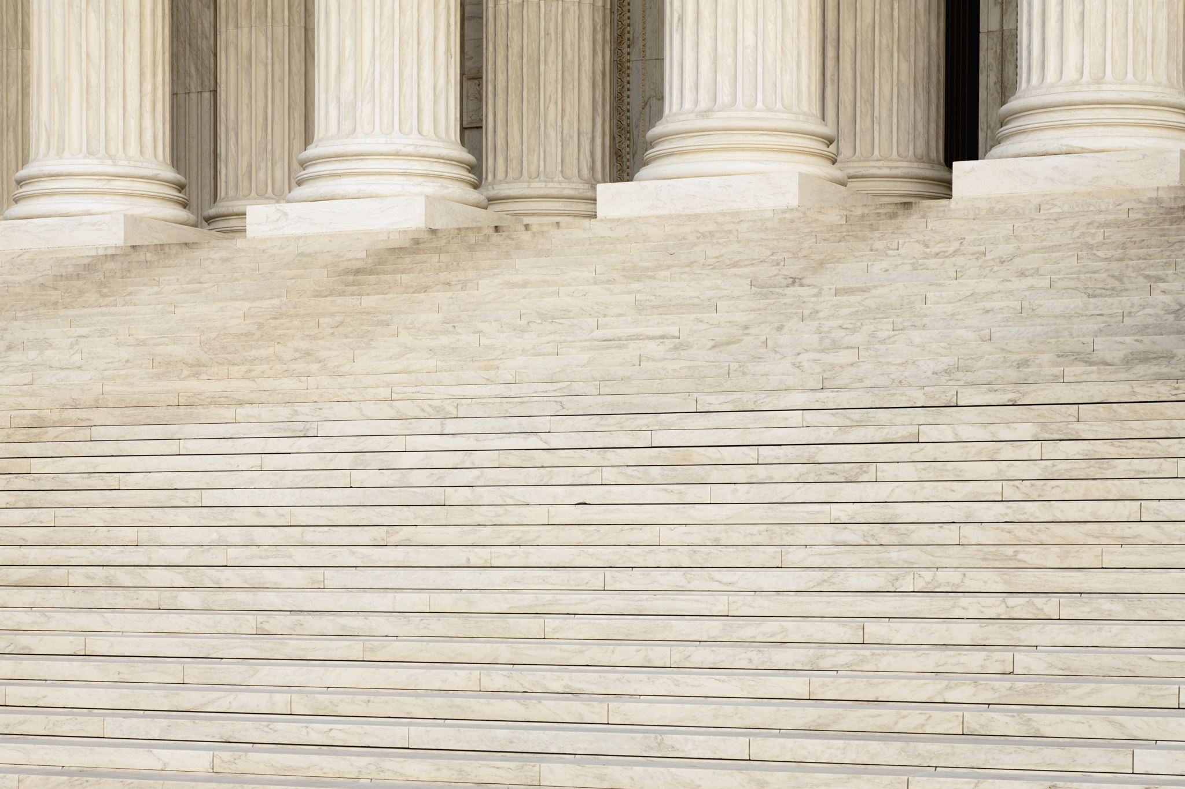
Legislative Update
88th Session of the Texas Legislature
Presented by ESC -13
Terry Smith

Slide 2
Statistics for the 88th Regular Session
Bills Filed – 8046
House Bills – 5413 (67%)
Senate Bills – 2633 (33%)
Bills Passed – 1246 (15.5%)
Bills Vetoed – 76 (6.2% of bills sent to governor’s desk)
Education Related Bills Tracked 1250 +
Education Bills in Bill Book ~ 100 (8% of passed bills)
Notes:
Most bills filed of any regular session and lowest percentage (not number) of bills passed by both chambers. Most vetoed bills from any regular session. Significantly less education related bills than last session, even though more were initially tracked. Last session we tracked about 11 bills and over 150 passed. This session I tracked over 1250 bills and under 100 passed.

Slide 3
Statistics for the 88th 1st and 2nd Special Sessions
Bills Filed – 138
House Bills – 103
Senate Bills – 35
Bills Passed – 2 (both passed in 2nd Special)
Bills Vetoed – 0
Education Related Bills Tracked 50+
Education Bills in Bill Book - 1 passed bills
Notes:
A total of two bill and one joint resolution passed during the 2nd special session.

Slide 4
Session Highlights/Lowlights
Dynamics of the 88th
Conflict between Governor, Lieutenant Governor and Speaker of the House reached a fever pitch.
Each chamber blaming the other for lack of activity.
Continued trend of increased party politics.
Priorities of the 88th
School/Child Safety
Tax Relief
Parent Rights
Limiting Authority of Local Governments (counties, cities, school districts)
School Choice – Senate & Governor
Data Privacy
Teachers/Retired Teachers
Economic Development
Infrastructure
Border Security
Notes:
More of a laundry list than specific priorities. Of note, curriculum and instruction was not a priority area, but HB 1605 is one of the more significant instruction bills passed in recent sessions.

Slide 5
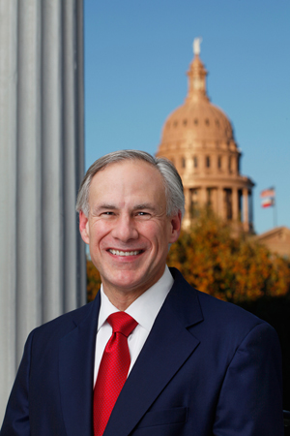
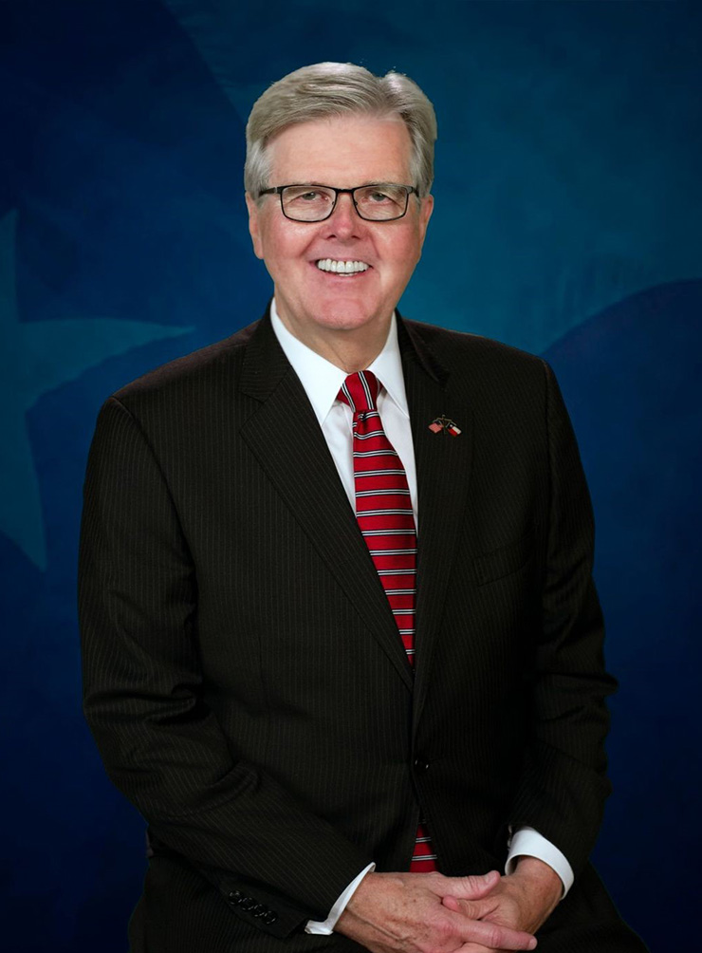
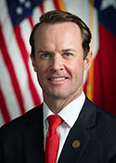
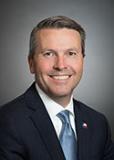
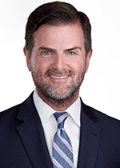
Leadership
Lieutenant Governor Dan Patrick
Governor Greg Abbott
Speaker of the House Dade Phelan
Speaker of the House
Dade Phelan (R)
House Public Education Chair Brad Buckley
Senate Education Chair Brandon Creighton
Notes:
Both chambers’ education committees had new chairs appointed for the 88th session. Chairman Buckley is a former school board member, and his spouse is a career educator. Chairman Creighton is an attorney. I do not know any direct connections to public education, but that is not to say he has none.

Slide 6
What bills & initiatives did not pass?
School Choice
Teacher Pay Increase
Increased School Funding – Basic Allotment
Enrollment Based Funding
Accountability/Testing Revisions
Notes:
It is pretty well assumed the next special session will be called in October and will be primarily about school choice and possibly teacher pay increases. For the second session in a row, multiple bills were filed that would have limited state assessments to the minimum number and subjects required by the department of education. Other bills would have added flexibility and rolled back some accountability measures. In both sessions, bills were filed by both chambers and both parties, with support from both sides of the aisles, and little opposition. However, all of the bills have died quietly. That said, there may be more to come. Another issue that received some attention in the 87th session and a lot more in the 88th session is enrollment-based funding instead of ADA based funding. A lot of folks assumed that the pandemic would usher in that move, but as with so many others, all of these bills quietly went away.

Slide 7
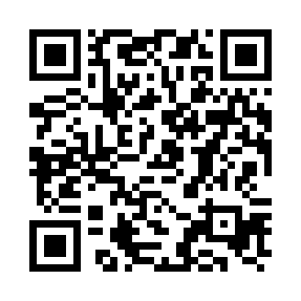
The “Slide Deck” is Comprised of Six Sections
Scan to view the digital version at esc13.info/billbook
School Safety and Security & Student Health (28 bills)
Learning - Assessment, Accountability & Instruction (18 bills)
Governance - District and Charter School Governance & Open Government (13 bills)
Money - School Finance & Property Tax (27 bills
People - Human Resources, TRS & Student-Specific (13 bills
2nd Special Session – Property Tax Relief (1 bill)
The bill number on each slide is linked to Texas Legislature Online
Notes:
Essentially all of the bills could be entered into a different section or could easily be included in multiple sessions. The arrangement is simply an attempt to organize bills with similar topics and that impact similar individuals or groups into a limited number of categories.

Slide 8
Major Bills
Senate Bill 1 – Appropriations Bill
HB 1605 – Instructional Materials
Senate Bill 3 – School Safety
Senate Bill 2 – Property Tax Relief
Notes:
With the exception of SB 1, each of the other three major bills have a separate summary.

Slide 9
More to come…
Impeachment Trial for Texas Attorney General Paxton – September
3rd Special Session for School Funding and School Choice – October
Election for Constitutional Amendments - November
Notes:
The 88th session is a gift that will keep giving, and there is no reason to assume there will be no more than one additional special session. The impeachment trial, and how it comes out in terms of perceived winners and losers will likely impact the filing, movement and passage of legislation in the next special session(s).

Slide 10
And now, onto the Slide Deck and a review of specific bills passed by the 88th Session of the Texas Legislature.
Notes:
In additional to the major bills, I would select individual bills with the most impact to review. You can also hide the slides you will not be reviewing, but since the numbering will not go away, participants can still keep up within the Slide Deck/Bill Book.

